Slide 1
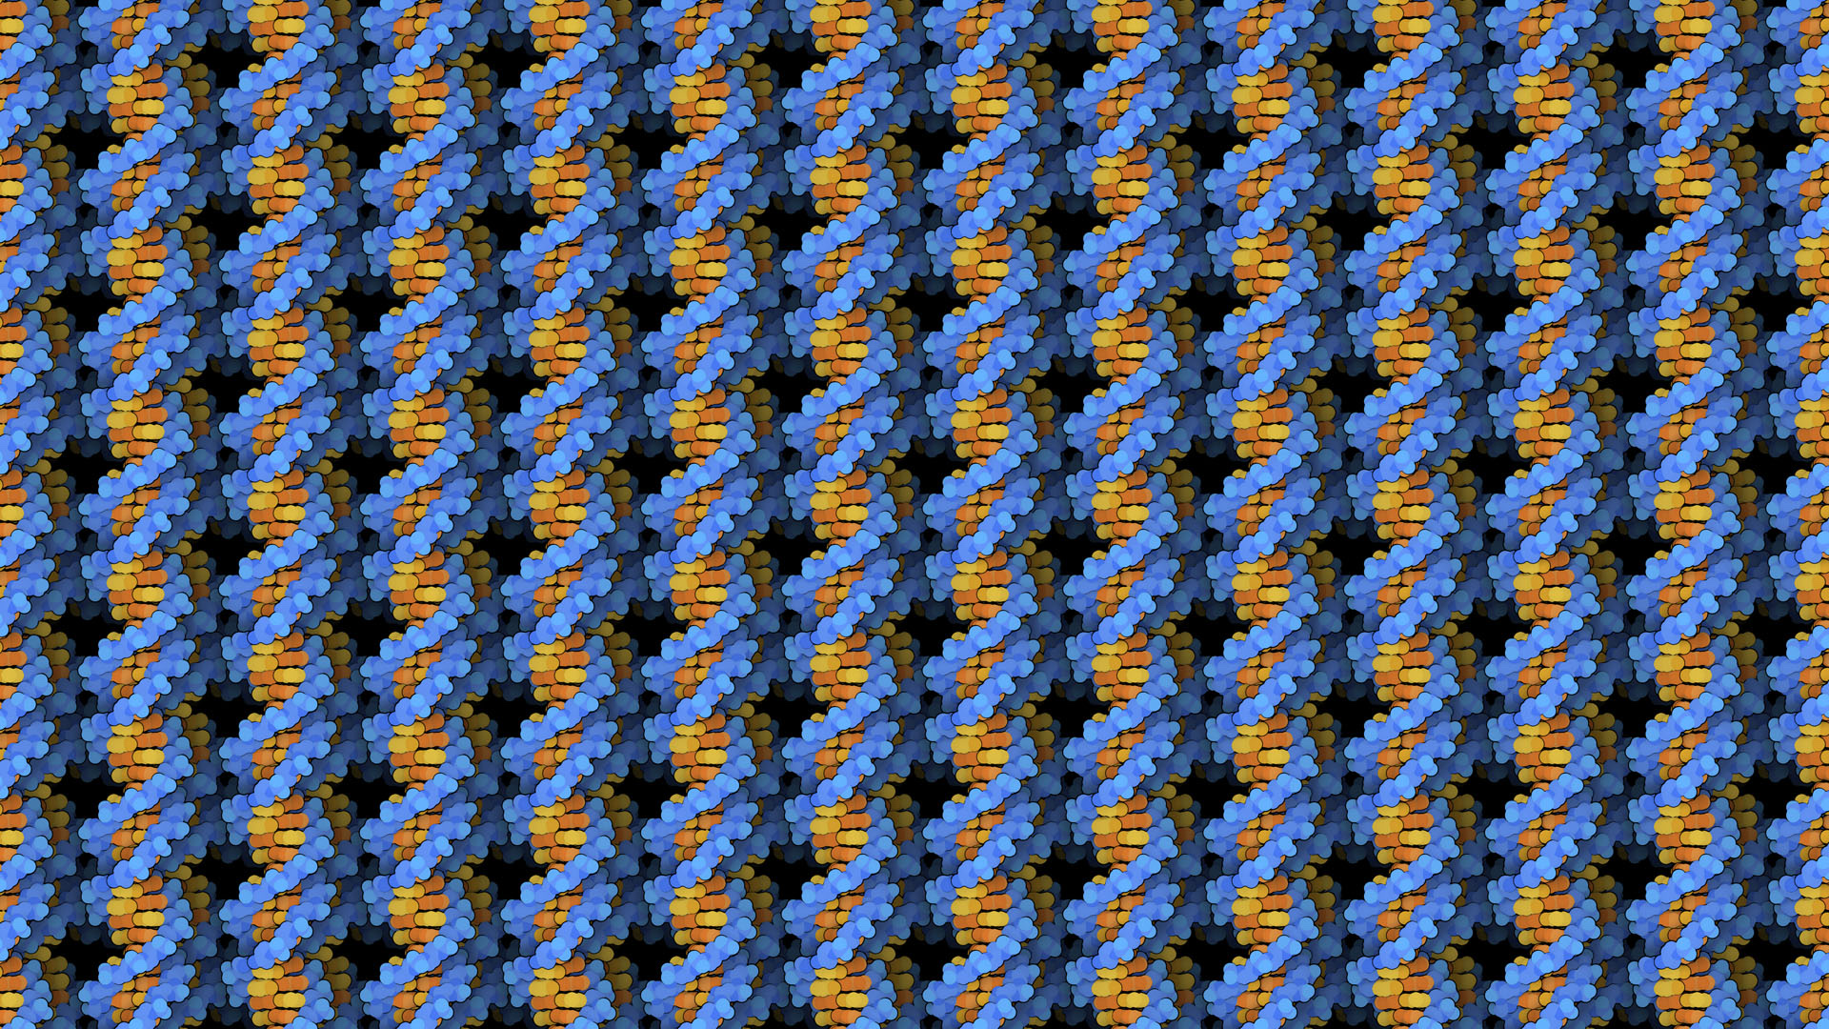
Molecular Modeling Program: Pymol (2)
Evan Edelstein
Notes:
https://pdb101.rcsb.org/learn/other-resources/molecular-backgrounds-for-virtual-meetings

Slide 2
Outline:
Review Of Selection Algebra
Publication Quality Images
Automation in Pymol

Slide 3
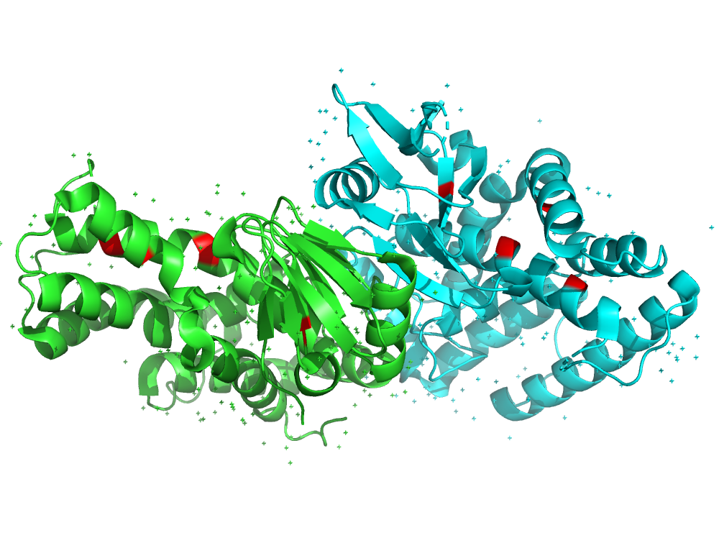
The Essence of Pymol:
Ask a Specific Biological Question
Manipulate the Selection’s Representation to Formulate a Hypothesis
Translate the Question Into a Pymol Selection
Example
Question: Is there a stabilizing disulfide bridge at the interface?
Selection: ’select cystines, resn CYS’
Hypothesis: No, it doesn’t seem that CYS-CYS interactions are important at this interface.

Slide 4
Case study - CD80:CTLA4 (1I8L) and CD86:CTLA4 (1I85)
Load
Load 1I8L into Pymol and color by chain.
Chains
Select chain B (cd80) and Chain D (ctla4) and hide the rest of the protein.
Residues
Select all the interface residues (100-105) on chain D. Show them as stick and add a label showing residue number.
Align
Load CD86 (1I85.B) and align with cd80.
Biological Question
Is there a difference in the ways CD80 and CD86 bind with CTLA4?
Contacts
Make a new selection of CD80/CD86 residues 3.5 Angstroms around the ctla4 interface.
Selection
Notes:
fetch 1i8l
create cd80, chain B
create ctla4, chain D
delete 1i8l
select interface, ctla4 and resi 100-105
show sticks, interface
select interface_ca, interface and name CA
label interface_ca , "(%s, %s)" % (resn, resi)
fetch 1i85
create cd86, 1i85 and chain B
delete 1i85
align cd86, cd80
orient interface
util.cbc
util.cnc
select cd86_contacts,byres interface around 3.5 and cd86
show sticks, cd86_contacts
select cd80_contacts,byres interface around 3.5 and cd80
show sticks, cd80_contacts

Slide 5
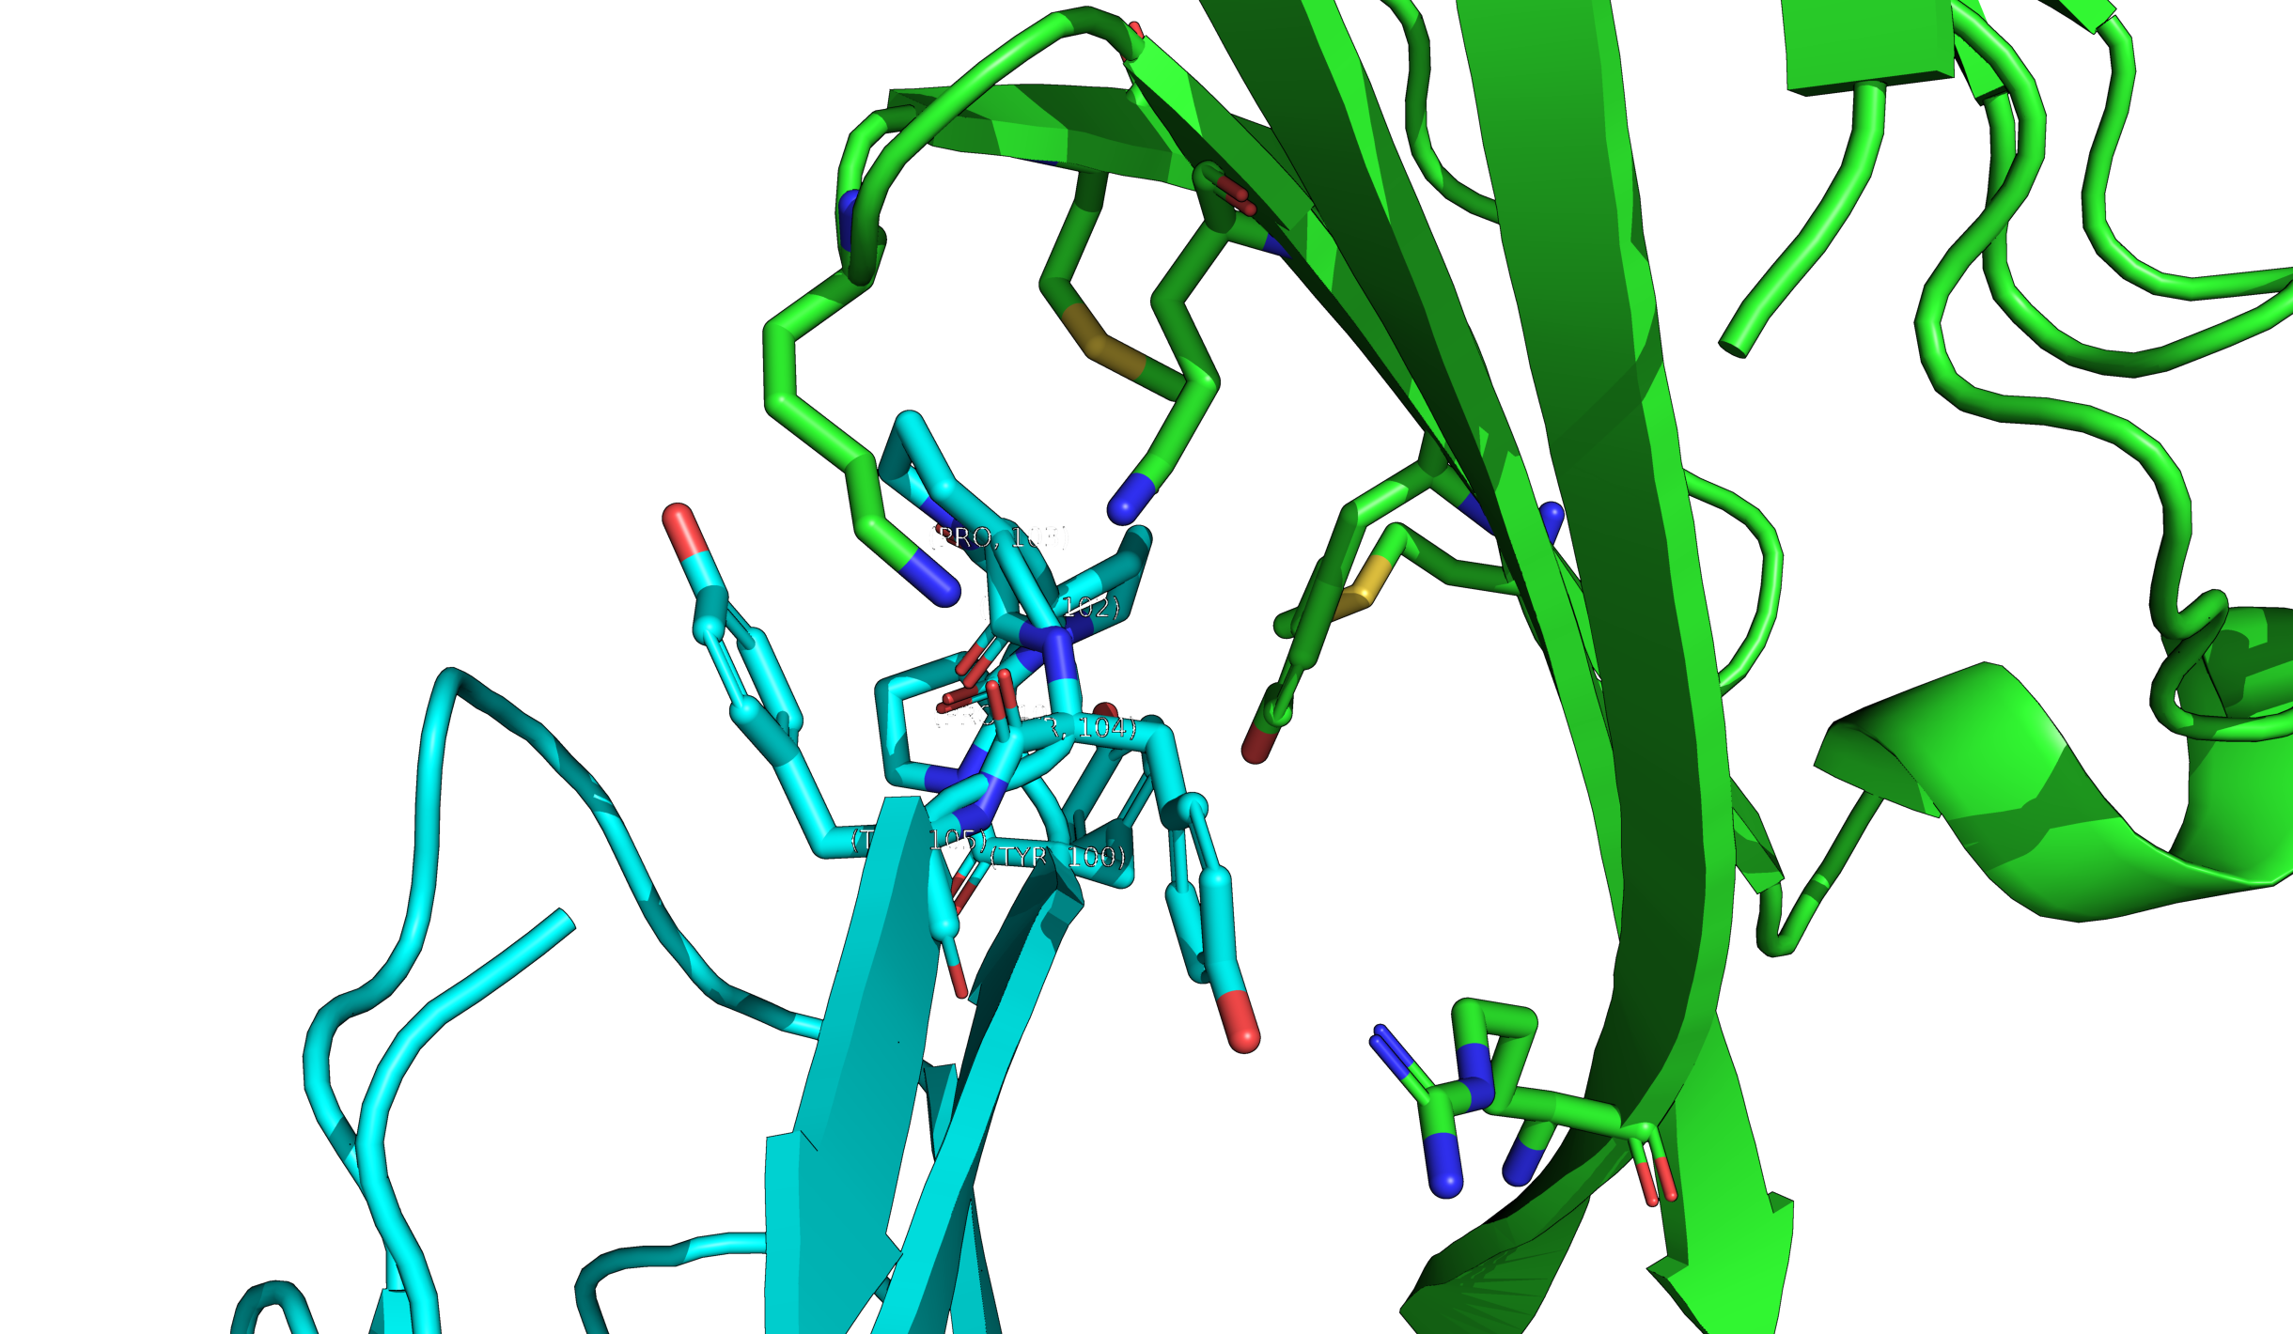
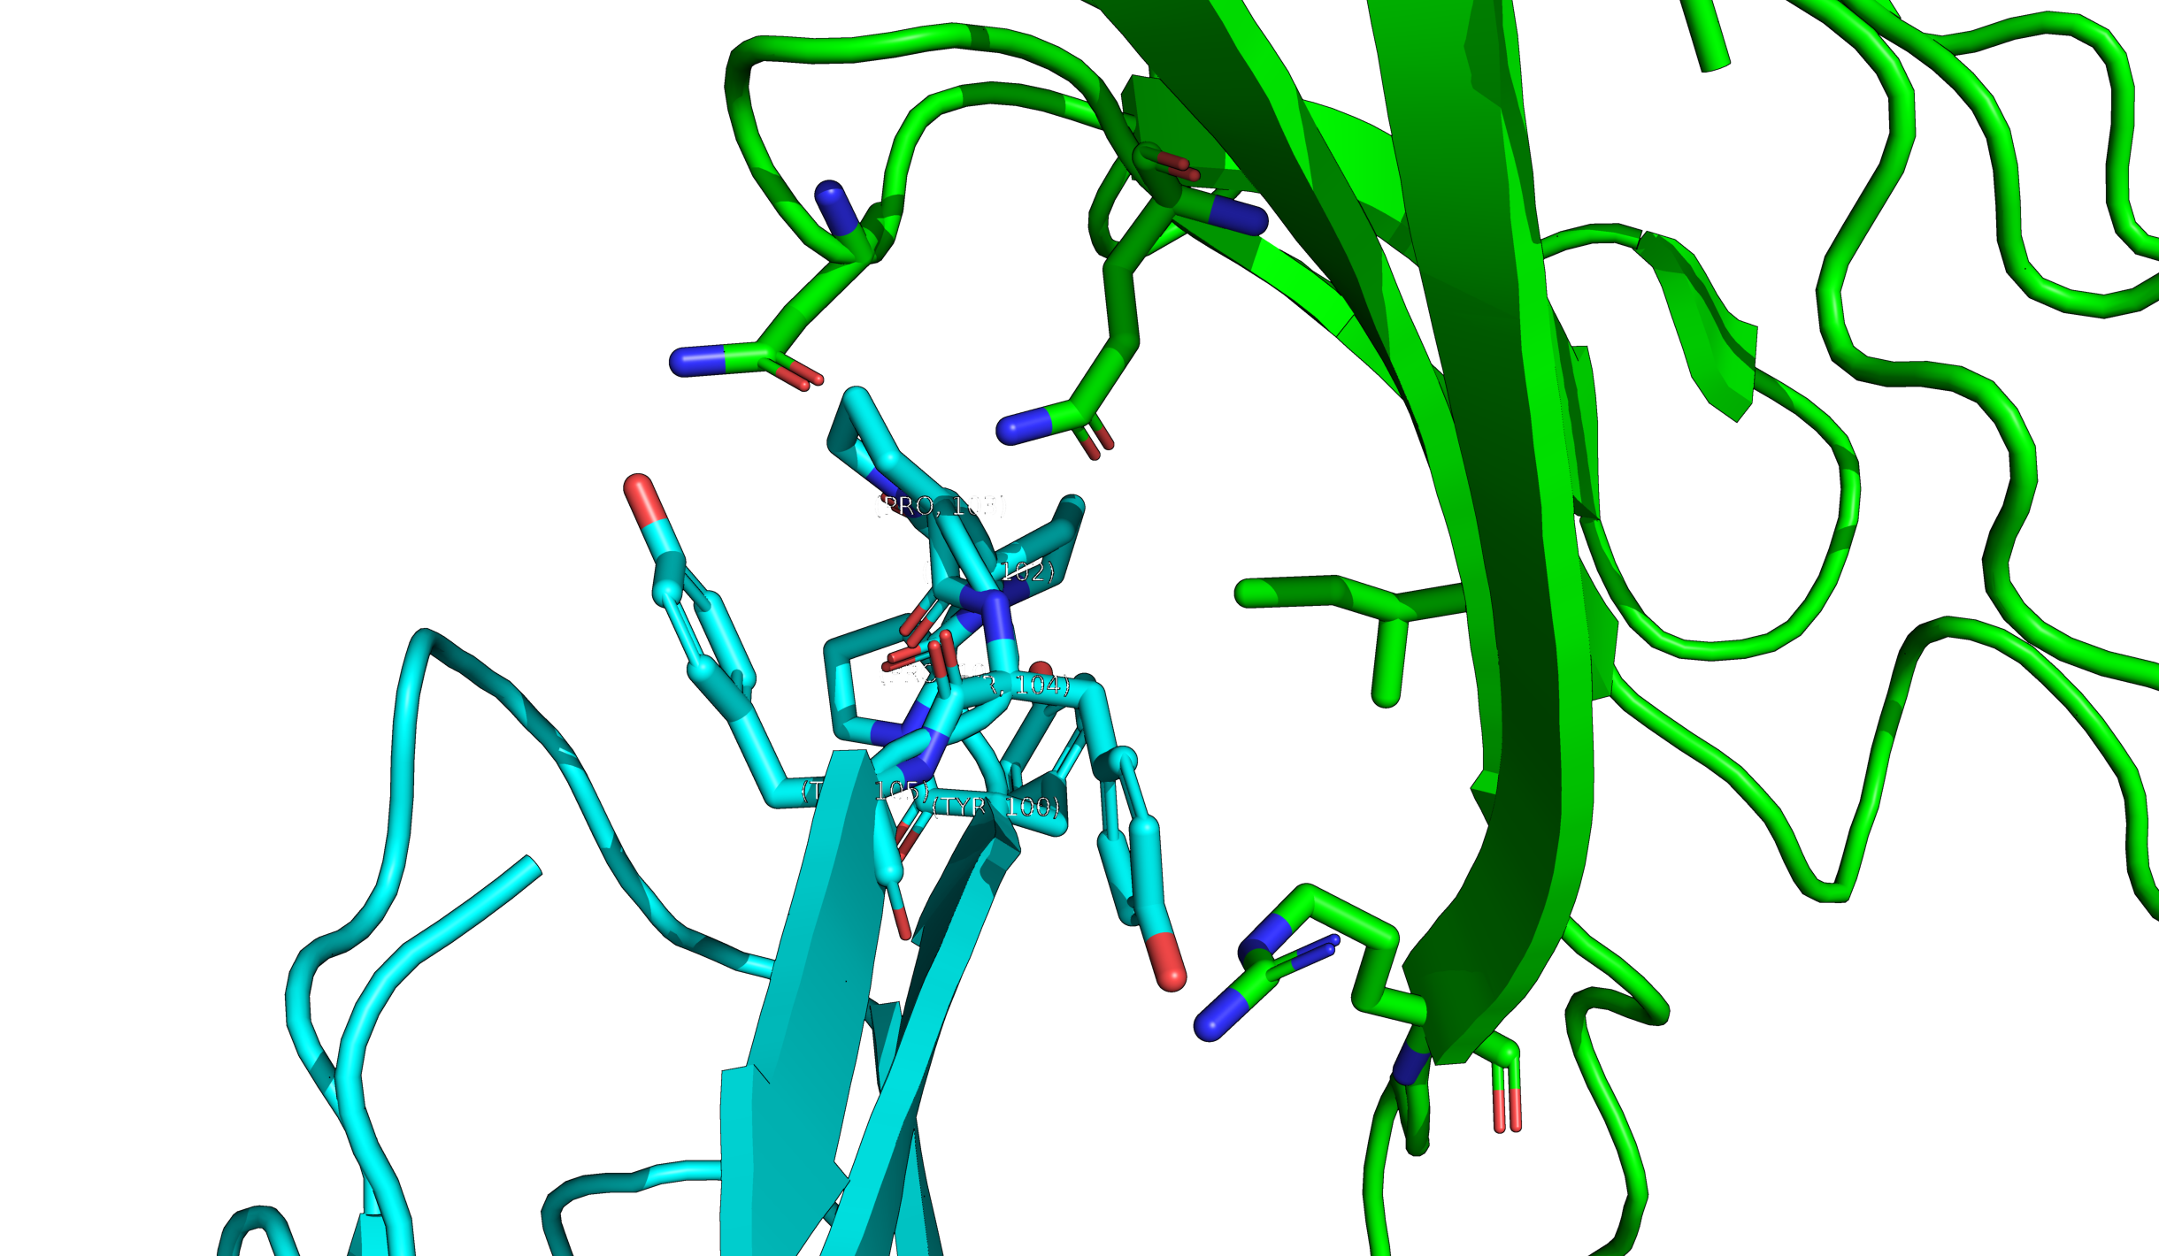
Case study - CD80:CTLA4 (1I8L) and CD86:CTLA4 (1I85)
CTLA4:CD86
CTLA4: CD80
What Hypothesis can you draw from this?
RMSD = 1.490

Slide 6
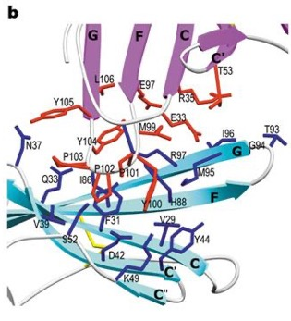
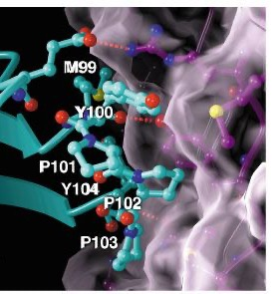
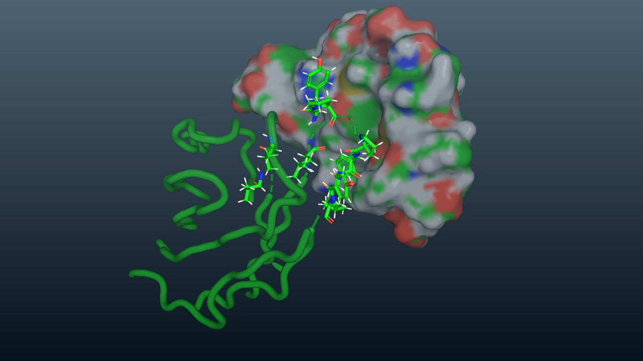
CTLA4:CD80 and CTLA4:CD86 in the Literature:
CTLA4:CD86
CTLA4:CD80
CTLA4:CD86
CTLA4
CTLA4
CD80
CD80
CD86
(2001) Nature 410: 604-608
(2001) Nature 410: 608-611
(Last Night) Me

Slide 7
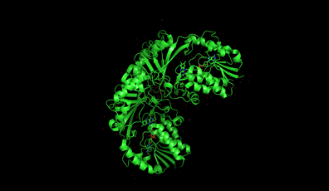
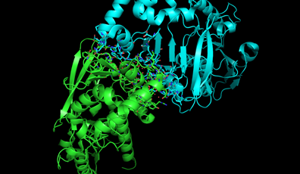
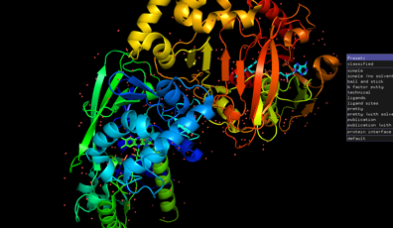
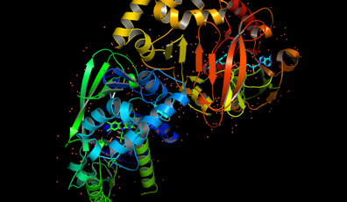
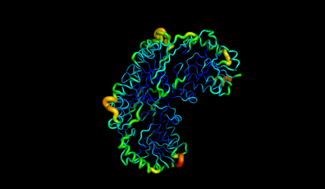
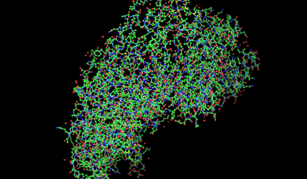
Publication Quality Images: Presets
Normal
Interface
Pretty
Publication
B-Factor
Ball and Stick

Slide 8
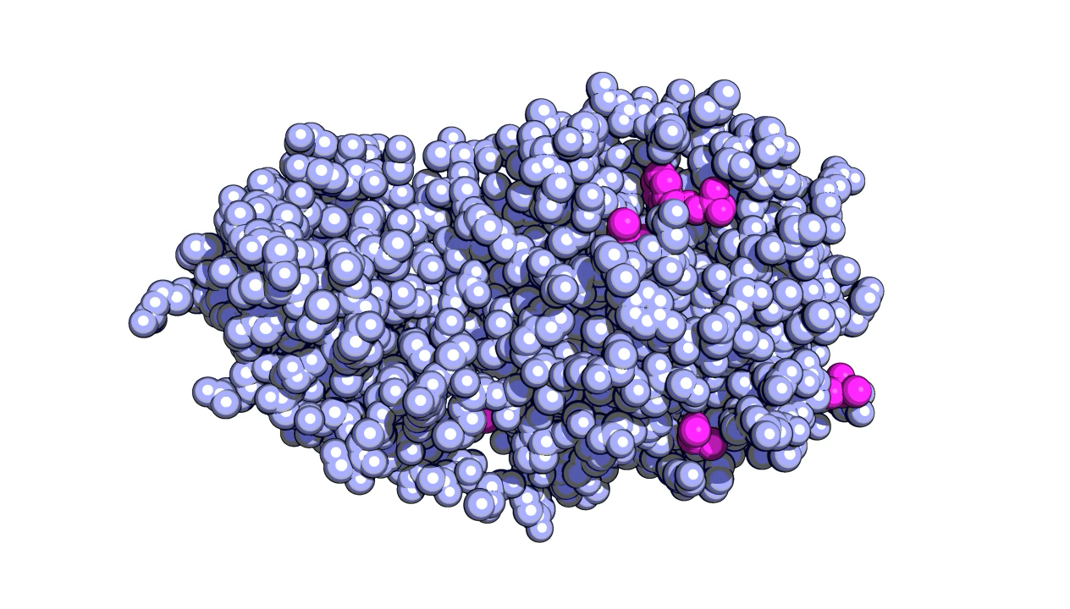
Publication Quality Images:
Selection transparency:
set `representation`_transparency, F, selection
Background transparency and color:
bg_color `color`
set ray_opaque_background, 1
Ray tracing:
set ray_trace_mode, 1
set antialias, 2
set ray_shadows, on
set ray_trace_color, black
set ray_trace_gain, 0
set ray_trace_fog=0
To render the image type ray
Saving:
png `filename`, dpi= 360, ray =1
For the value of F, 1.0 will be an invisible and 0.0 a completely solid surface.
util.cnc
util.cbc
Sars-cov-2 main protease: 5R7Y
Notes:
https://pymolwiki.org/index.php/Gallery

Slide 9
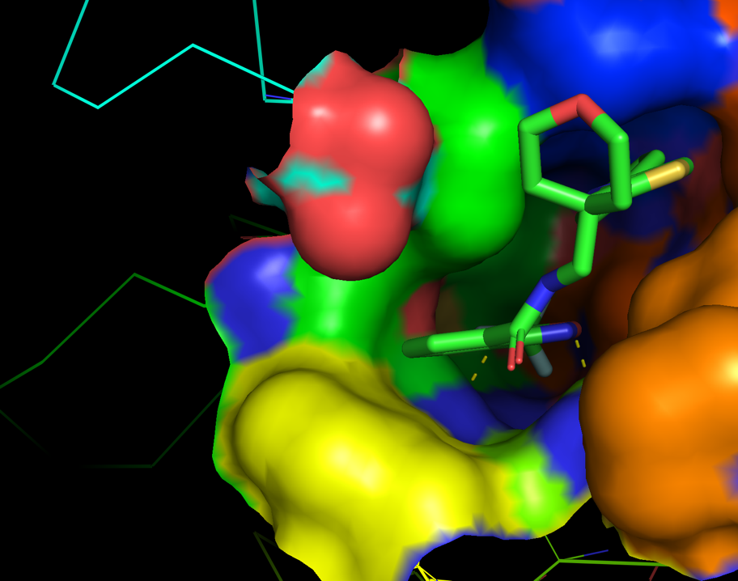
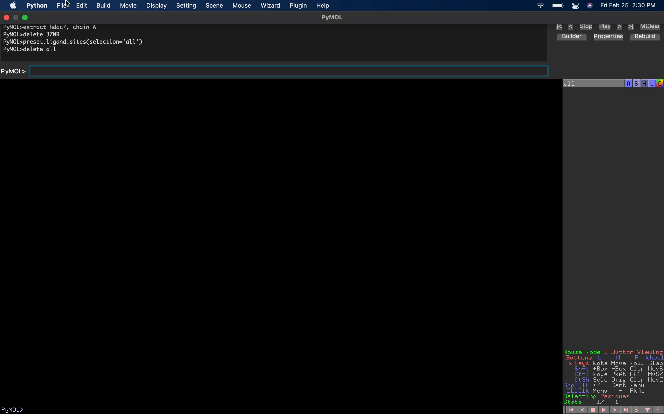
Automation in Pymol: PML Scripts
fetch 3ZNR
create hdac7, chain A
delete 3ZNR
preset.ligand_sites(selection=’all’)
Notes:
HDAC7-TMP

Slide 10

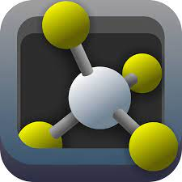
Automation in Pymol: Python API
Python Code can be written inside a .pml script by using a python…python end block.
All Pymol commands can be accessed as method calls to the cmd object:
Ex: fetch 1i8l -> cmd.fetch(“1i8l”)
These “API” calls can return values:
Ex: rmsd = cmd.align(template, query)

Slide 11
Case study: PDL-1 and PD-1
Load
Load the template PL-1 (3BIK.B).
Drugs
Align
Align the Pd-1 with atezolizumab bound PDL-1.
Biological Question
How do different pdl-1 inhibitors compare to the wildtype ligand pd-1?
Load PDL-1 bound with drug atezolizumab (5XXY).
Selection
Notes:
python
template = "3BIK"
cmd.fetch(template)
cmd.extract("pdl1",f"chain A")
cmd.fetch(“5XXY”)
cmd.extract(drug,f"{pdb} and chain H+L”)
align_out_list = cmd.align(drug,"3BIK")
rmsd = float(align_out_list[0])
print(drug,rmsd)

Slide 12
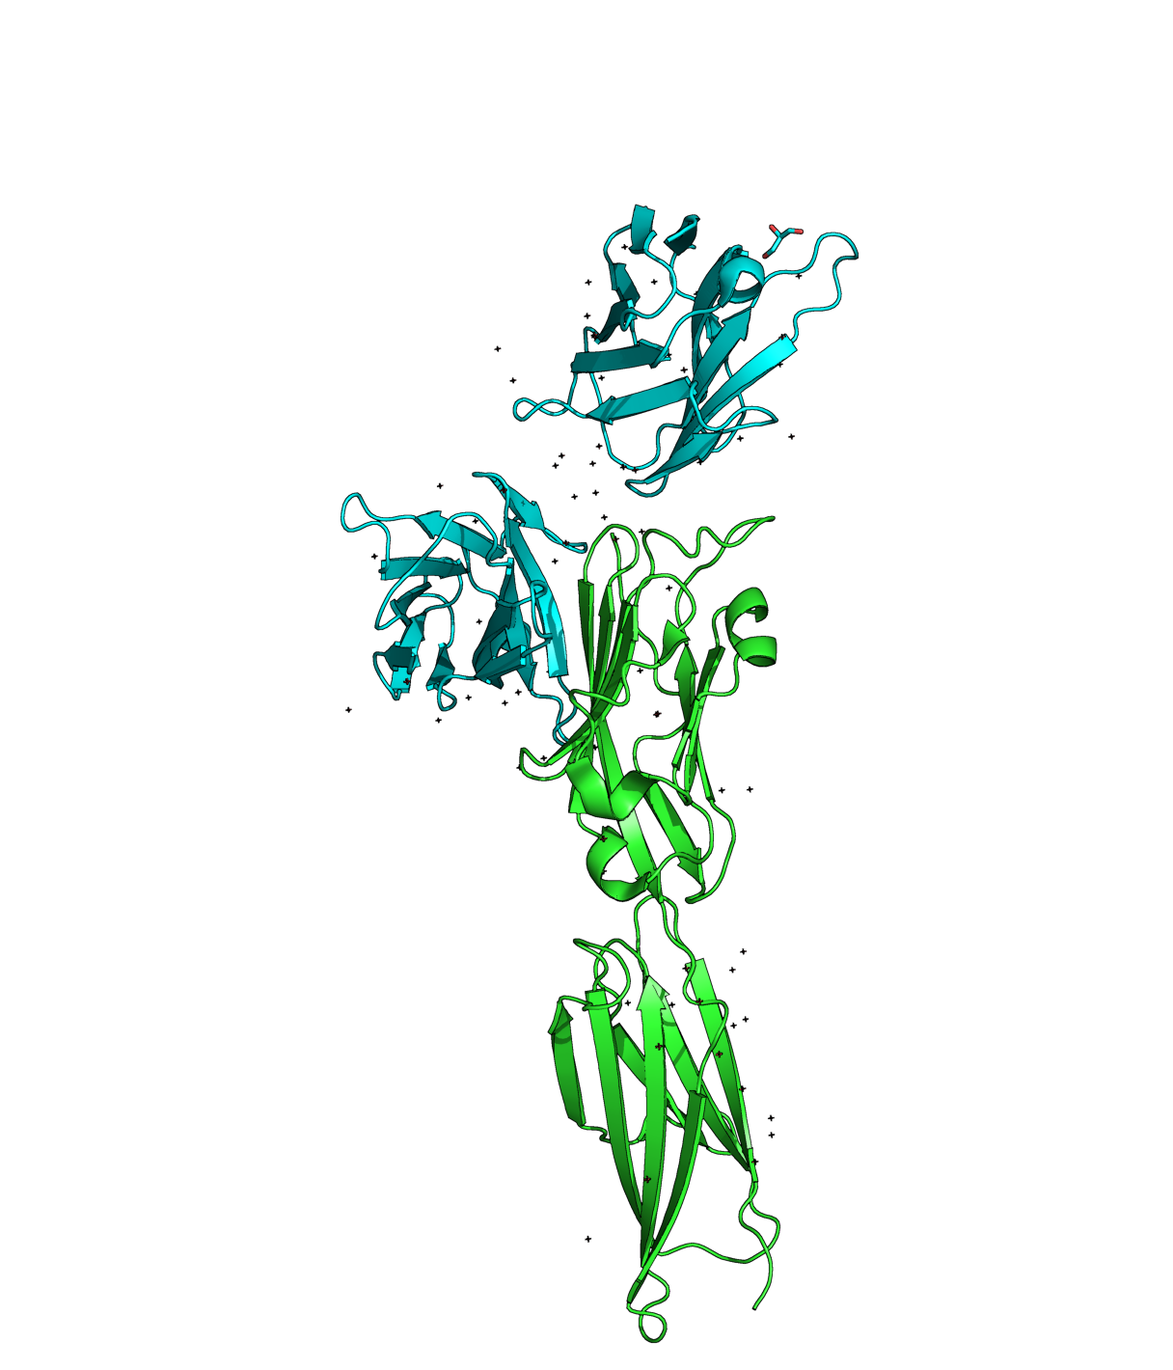
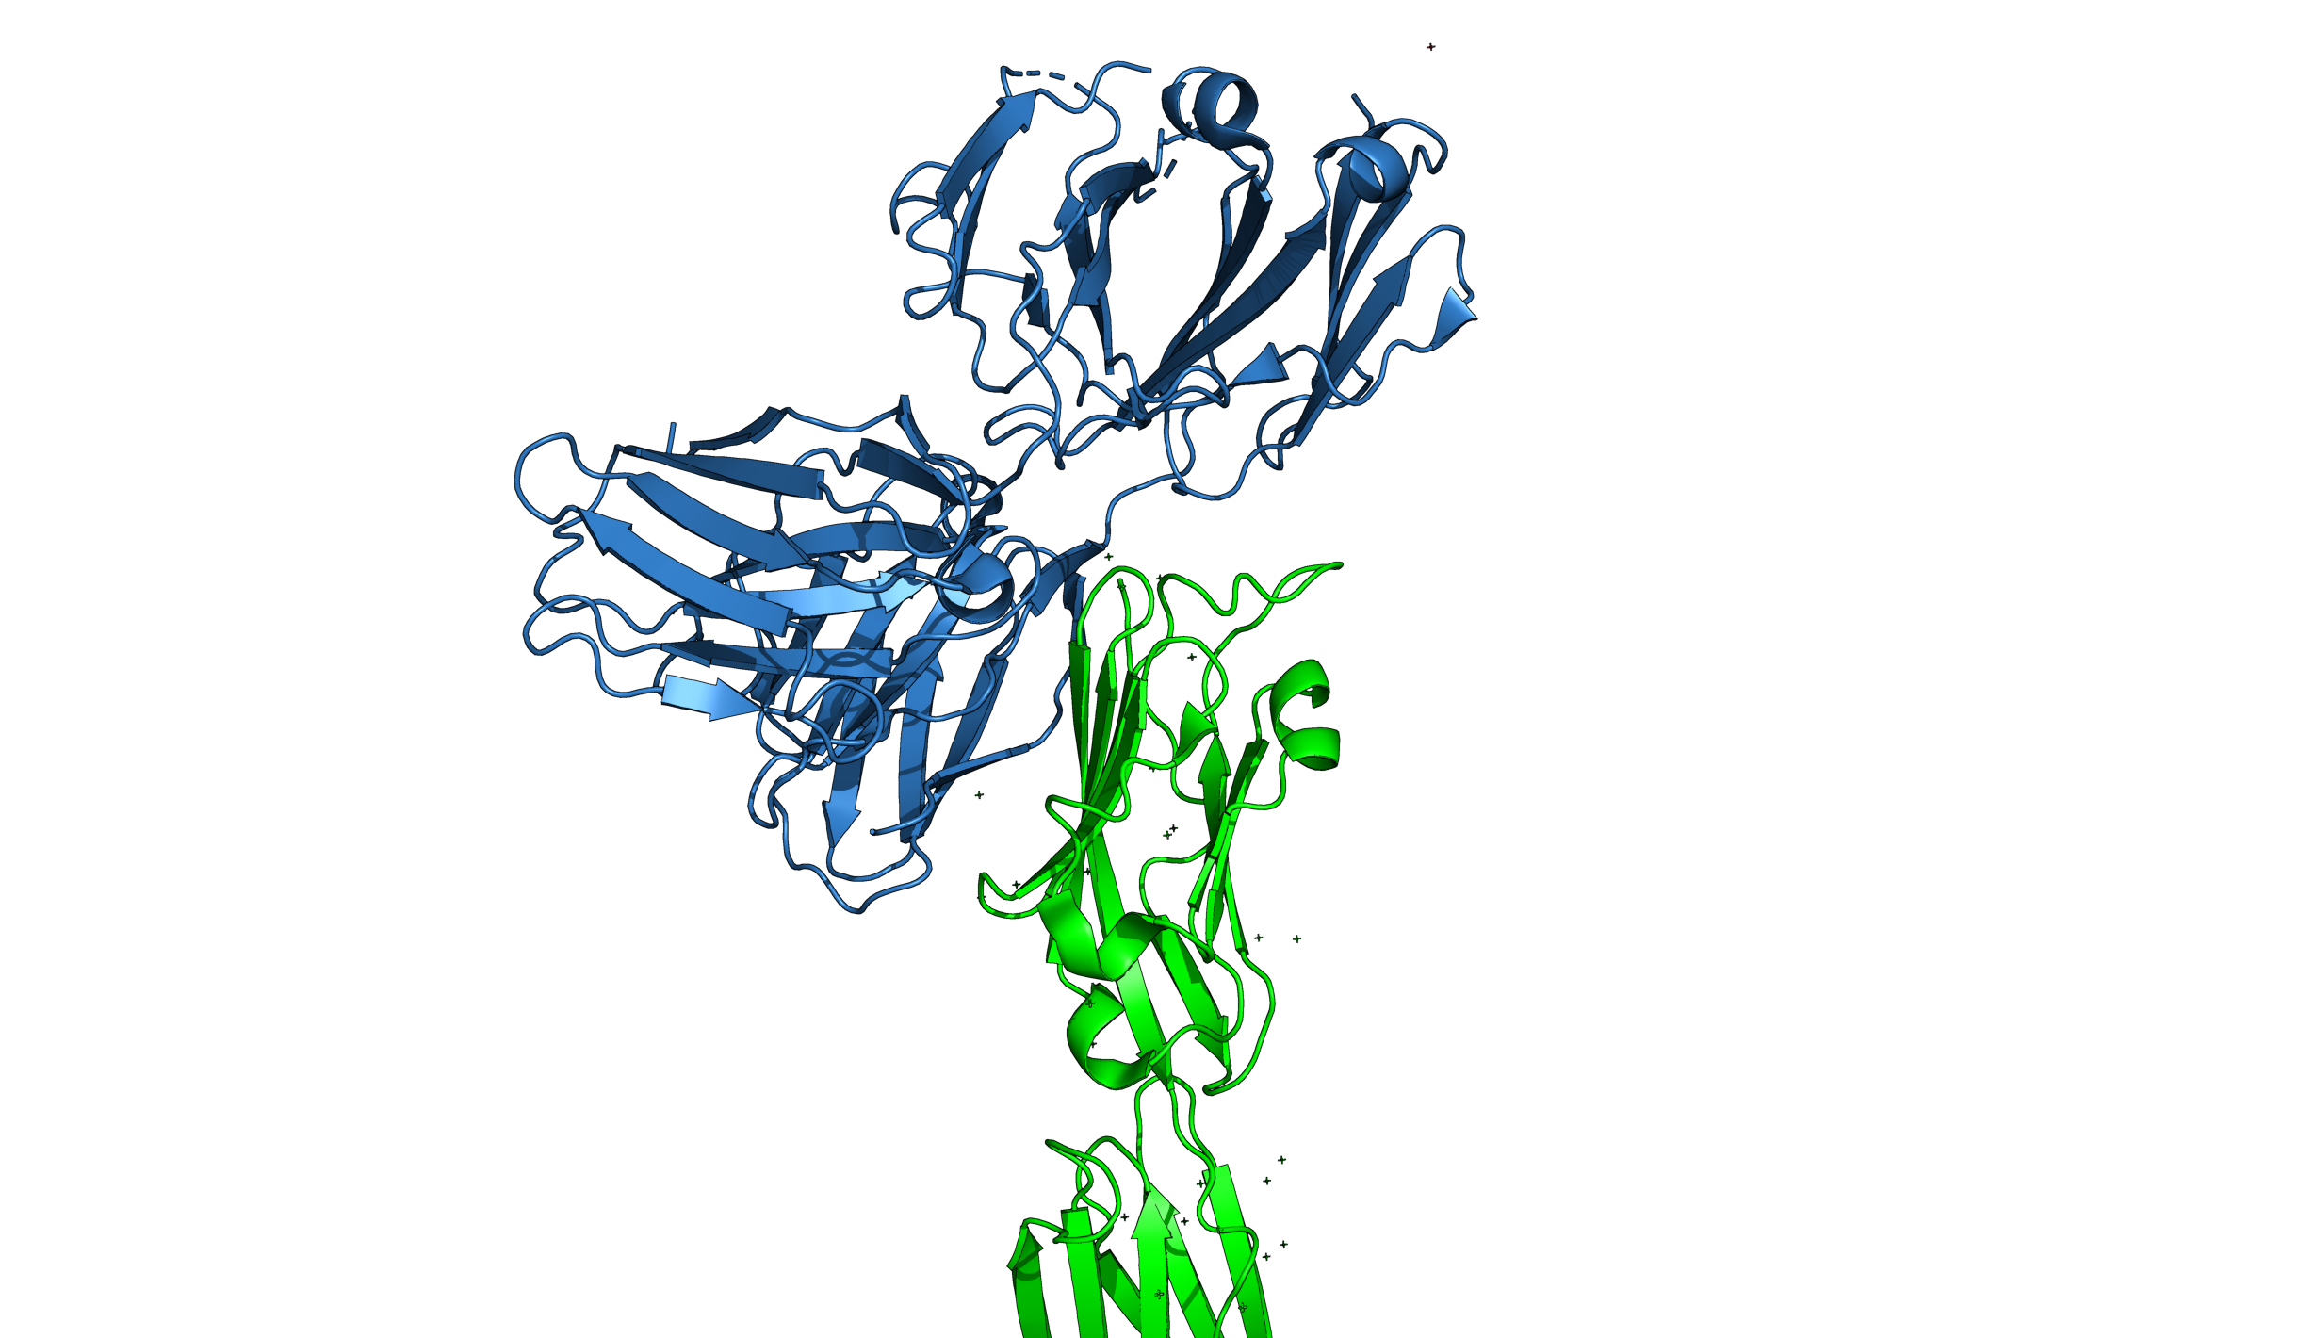
Case study: PDL-1 and PD-1
Atezolizumab RMSD: 15.77
PD-1 : PDL-1

Slide 13
Case study: PDL-1 and PD-1: For Loops
Drugs
Align
Align the wildtype PD-1 with each drug.
Biological Question
How do different pdl-1 inhibitors compare to the wildtype partner pd-1?
Load PDL-1 bound with drugs: atezolizumab (5XXY) , durvalumab
(5X8M) and JQT(6R3K).
Selection
Notes:
python
template = "3BIK"
cmd.fetch(template)
cmd.extract("pdl1",f"chain A")
queries = {
"atezolizumab": ["5XXY",["H","L"]],
"durvalumab": ["5X8M",["B","C"]],
"JQT":["6R3K",["B","D"]]
}
for drug in queries:
pdb, chains = queries[drug]
cmd.fetch(pdb)
chains_str = "+".join(chains)
cmd.extract(drug,f"{pdb} and chain {chains_str}")
align_out_list = cmd.align(drug,"3BIK")
rmsd = float(align_out_list[0])
print(drug,rmsd)
cmd.orient(drug)
cmd.hide(selection=pdb)
python end

Slide 14
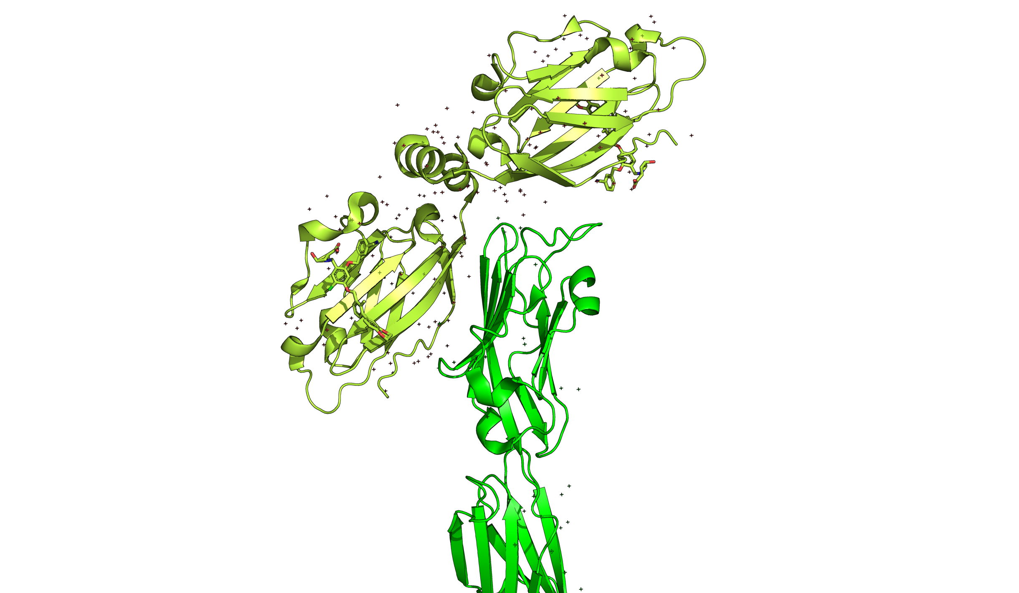
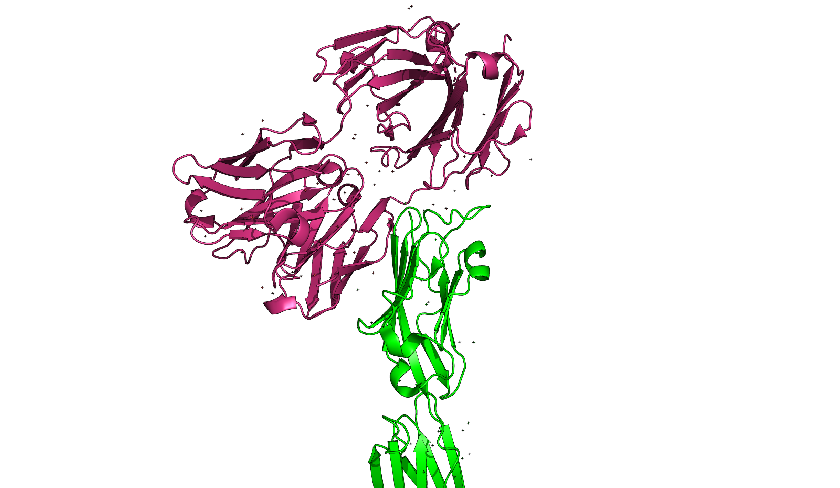
Case study: PDL-1 and PD-1
durvalumab
Atezolizumab
JQT
Drug | RMSD
durvalumab (5X8M) | 16.47
atezolizumab (5XXY) | 15.77
JQT (6R3K) | 18.36
What Hypothesis can you draw from this?
Notes:
https://www.cell.com/iscience/pdf/S2589-0042(20)31157-3.pdf

Slide 15
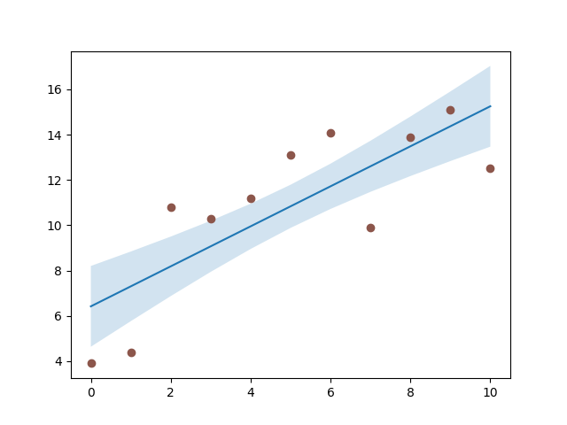
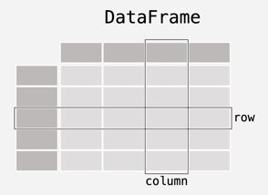


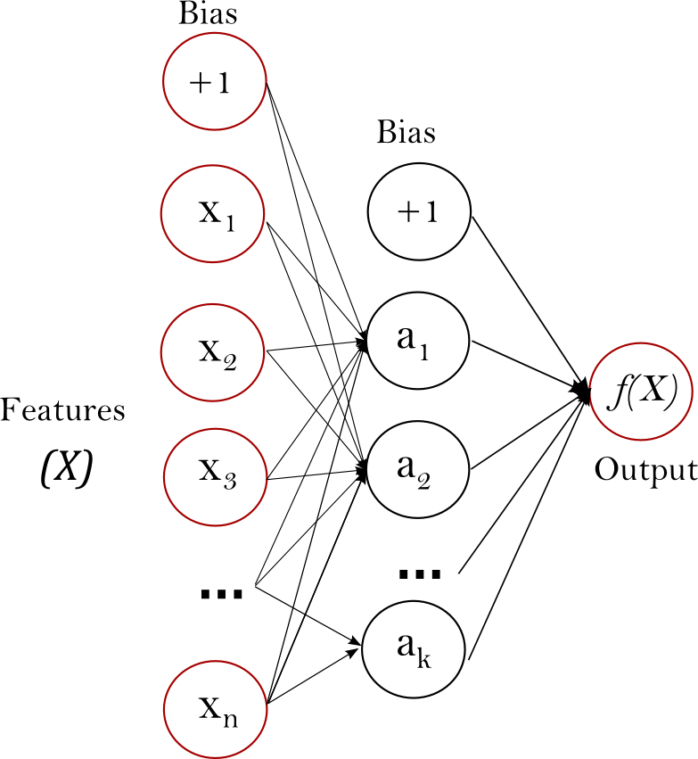
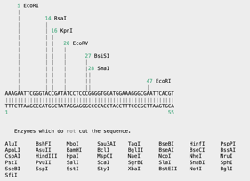


Do More With Python:

